Slide 1

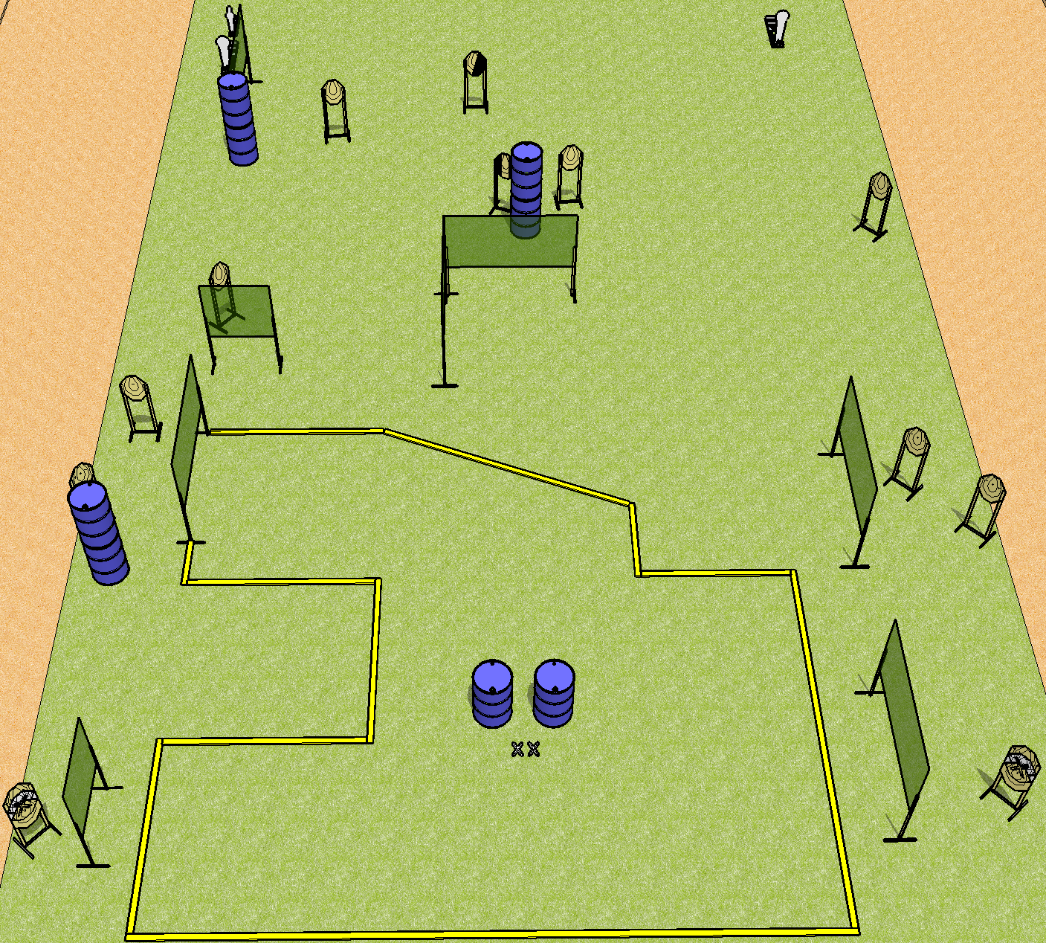
 | Dothan Practical Shooters – USPSA Match Odd Course Designer : Drew Coleman Bay: B1
Round Count 31 rounds 14 IPSC 2 colt poppers, 1 mini popper
Equipment List 13 wall feet 1 tux + 1 right diag 14 targets (12 + 2NS)

Slide 2
Odd
Written Stage Briefing
Scoring: Comstock Rounds: 31
Targets: 14 IPSC, 3 steel
Start position: feet on X’s, palms on marks. Firearm is unloaded on either barrel, unpropped. First magazine to be used on stage is on the opposite barrel.
Stage Procedure: on the audible start signal, engage targets as they become available from within the shooting area.

